Slide 1
Transport Layer: Part II
Efficient Reliable Data Transfer Protocols
  Go-Back-N and Selective Repeat
Round Trip Time Estimation
Flow Control
Congestion Control
Readings: Sessions 3.4-3.7, Lecture Notes
CSci4211: Transport Layer: Part II

Slide 2
Recall:
Simple Reliable Data Transfer Protocol
“Stop-and-Wait” Protocol
  also called Alternating Bit Protocol
Sender:
  i) send data segment (n bytes) w/ seq =x
    buffer data segment, set timer, retransmit if time out
  ii) wait for ACK w/ack = x+n; if received, set x:=x+n, go to i)
    retransmit if ACK w/ “incorrect” ack no. received
Receiver:
  i) expect data segment w/ seq =x; if received, send ACK w/ ack=x+n, set x:=x+n, go to i)
    if data segment w/ “incorrect” seq no received, discard data segment, and retransmit ACK.
CSci4211: Transport Layer: Part II

Slide 3

Problem with Stop-and-Wait
Problem with Stop & Wait Protocol
Sender
Receiver
first packet bit transmitted, t = 0
data (L bytes)
first packet bit arrives
RTT
ACK
ACK arrives, send next packet, t = RTT + L / R
Can’t keep the pipe full
  Utilization is low
  when bandwidth-delay product (R x RTT)is large!
CSci4211: Transport Layer: Part II

Slide 4
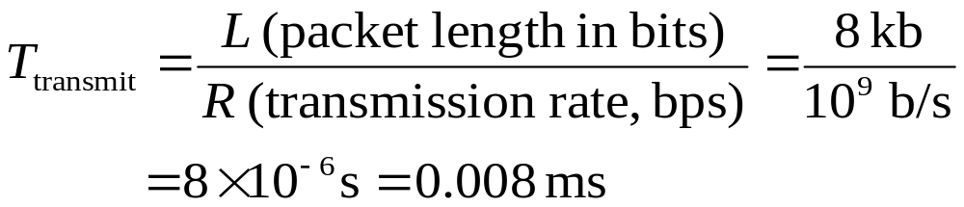
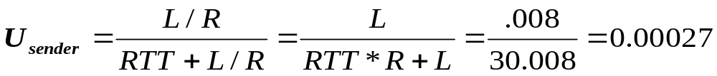
Stop & Wait: Performance Analysis
Example:
1 Gbps connection, 15 ms end-end prop. delay,
data segment size: 1 KB = 8Kb
  U _{sender}: utilization, i.e., fraction of time sender busy sending
  1KB data segment every 30 msec (round trip time)
  --> 0.027% x 1 Gbps = 33kB/sec throughput over 1 Gbps link
  Moral of story:
  network protocol limits use of physical resources!
CSci4211: Transport Layer: Part II

Slide 5
Pipelined Protocols
Pipelining: sender allows multiple, “in-flight”, yet-to-be-acknowledged data segments
  range of sequence numbers must be increased
  buffering at sender and/or receiver
Two generic forms of pipelined protocols:
Go-Back-N and Selective Repeat
CSci4211: Transport Layer: Part II

Slide 6

Pipelining: Increased Utilization
sender
receiver
first packet bit transmitted, t = 0
last bit transmitted, t = L / R
first packet bit arrives
RTT
last packet bit arrives, send ACK
last bit of 2nd packet arrives, send ACK
last bit of 3rd packet arrives, send ACK
ACK arrives, send next
packet, t = RTT + L / R
Increase utilization
by a factor of 3!
CSci4211: Transport Layer: Part II

Slide 7
Go-Back-N: Basic Ideas
Sender:
  Packets transmitted continually (when available) without waiting for ACK, up to N outstanding, unACK’ed packets
  A logically different timer associated with each “in-flight” (i.e., unACK’ed) packet
    timeout(n): retransmit pkt n and all higher seq # pkts in window
Receiver:
  ACK packet if corrected received and in-order, pass to higher layer, NACK or ignore corrupted or out-of-order packets
  “cumulative” ACK: if multiple packets received corrected and in-order, send only one ACK with ack= next expected seq no.
CSci4211: Transport Layer: Part II

Slide 8

Go-Back-N: Sliding Windows
Sender:
“window” of up to N, consecutive unack’ed pkts allowed
send_base: first sent but unACKed pkt, move forward when ACK’ed
expected, not received yet
may be received
(and can be buffered,
but not ACK’ed)
rcv_base
Receiver:
rcv_base: keep track of next expected seq no, move forward when next in-order (i.e., w/ expected seq no) pkt received
CSci4211: Transport Layer: Part II

Slide 9

GBN in Action
CSci4211: Transport Layer: Part II

Slide 10
Selective Repeat
As in Go-Back-N
  Packet sent when available up to window limit
Unlike Go-Back-N
  Out-of-order (but otherwise correct) is ACKed
  Receiver: buffer out-of-order pkts, no “cumulative” ACKs
  Sender: on timeout of packet k, retransmit just pkt k
Comments
  Can require more receiver buffering than Go-Back-N
  More complicated buffer management by both sides
  Save bandwidth
    no need to retransmit correctly received packets
CSci4211: Transport Layer: Part II

Slide 11

Selective Repeat: Sliding Windows
CSci4211: Transport Layer: Part II

Slide 12
Selective Repeat: Algorithms
sender
receiver
pkt n in [rcvbase, rcvbase+N-1]
send ACK(n)
out-of-order: buffer
in-order: deliver (also deliver buffered, in-order pkts), advance window to next not-yet-received pkt
pkt n in [rcvbase-N,rcvbase-1]
ACK(n)
otherwise:
ignore
data from above :
if next available seq # in window, send pkt
timeout(n):
resend pkt n, restart timer
ACK(n) in [sendbase,sendbase+N]:
mark pkt n as received
if n smallest unACKed pkt, advance window base to next unACKed seq #
CSci4211: Transport Layer: Part II

Slide 13
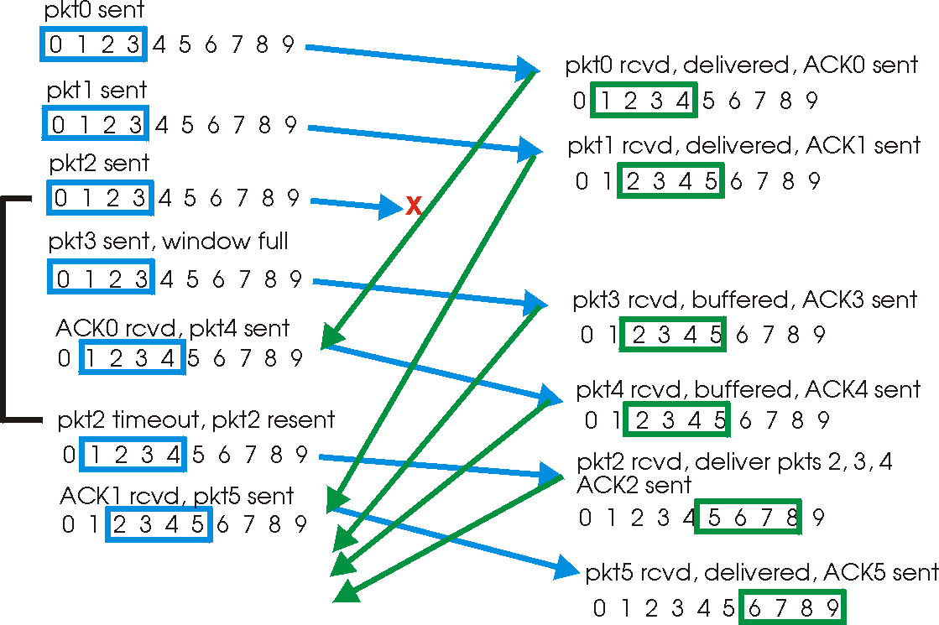
Selective Repeat in Action
CSci4211: Transport Layer: Part II
Notes:
First thing to be noticed here is that receiver also maintains a window. It accepts a packet as an original one only if its seqno falls within its window. When it receives the pkt 0, it moves/slides the window by one. Now lets suppose that pkt 2 is lost. So receiver gets pkt3. Unlike in go-back-n, here the pkt 3 is buffered and an individual ack3 is sent. When the retransmission timer for pkt2 is expired, only that packet is retransmitted. Once the receiver gets pkt2, then it hands over pkts 2,3 and 4 in order to the upper layer.

Slide 14

Selective Repeat:
Dilemma
Example:
seq #’s: 0, 1, 2, 3
window size=3
receiver sees no difference in two scenarios!
incorrectly passes duplicate data as new in (a)
Q: what relationship between seq # size and window size?
CSci4211: Transport Layer: Part II

Slide 15
Seqno Space and Window Size
How big the sliding window can be?
  MAXSEQNO: number of available sequence numbers
  Under Go-Back-N?
    MAXSEQNO will not work, why?
  What about Selective-Repeat?
CSci4211: Transport Layer: Part II
Notes:
We have seen that in case of stop-and-wait where window size is 1, we need only 1 bit to represent seqno’s 0 or 1. When we allow multiple pkts to be in transit, we need bigger seqno space to be able to distinguish between different pkts and also their duplicates. Question is what is the relationship between the seqno space and the window size.
It turns out that under Go-Back-N, if the number of seqnos possible are N, then the window size can not be more than N-1. It is easy to see that this is the case with stop-and-wait where window size is 1 and we need two distinct seqno’s 0 and 1. In both the cases, since the receiver accepts only the expected seqno, it can only get confused between an original pkt and a duplicate pkt with the same expected seqno. By having window size to be one less than the possible seqno’s, we can avoid that possibility.
In case of selective repeat, the window size can not be more than N/2. When the window size is bigger, the receiver can not distinguish between a duplicate and an original transmission as illustrated in the next slide.

Slide 16
TCP Round Trip Time and Timeout
Q: how to set TCP timeout value?
longer than RTT
  but RTT varies
too short: premature timeout
  unnecessary retransmissions
too long: slow reaction to segment loss
Q: how to estimate RTT?
SampleRTT: measured time from segment transmission until ACK receipt
  ignore retransmissions, why?
SampleRTT will vary, want estimated RTT “smoother”
  average several recent measurements, not just current SampleRTT
CSci4211: Transport Layer: Part II

Slide 17


TCP Round Trip Time Estimation
EstimatedRTT = (1- )*EstimatedRTT + *SampleRTT
Exponential weighted moving average
influence of past sample decreases exponentially fast
typical value: = 0.125
Setting the timeout interval
EstimtedRTT plus “safety margin”
  large variation in EstimatedRTT -> larger safety margin
“safety margin”: accommodate variations in estimatedRTT
DevRTT = (1- )*DevRTT + *|SampleRTT-EstimatedRTT|
(typically, = 0.25)
TimeoutInterval = EstimatedRTT + 4*DevRTT
CSci4211: Transport Layer: Part II

Slide 18

Example RTT Estimation:
CSci4211: Transport Layer: Part II

Slide 19
TCP Reliable Data Transfer
TCP creates reliable data transfer service on top of IP’s unreliable service
Pipelined segments
Cumulative ACKs
TCP uses single retransmission timer
  double TimeoutInterval on timer expiration
Retransmissions are triggered by:
  timeout events
  duplicate acks
Initially consider simplified TCP sender:
  ignore duplicate acks
  ignore flow control, congestion control
CSci4211: Transport Layer: Part II

Slide 20
TCP Sender Events:
data rcvd from app:
Create segment with seq #
seq # is byte-stream number of first data byte in segment
start timer if not already running (think of timer as for oldest unacked segment)
expiration interval: TimeOutInterval
timeout:
retransmit segment that caused timeout
restart timer
ACK received:
If acknowledges previously unACKed segments, then
  update what is known to be ACKed
  start timer if there are outstanding segments
CSci4211: Transport Layer: Part II

Slide 21
TCP ACK generation [RFC 1122, RFC 2581]
Event at Receiver
Arrival of in-order segment with
expected seq #. All data up to
expected seq # already ACKed
Arrival of in-order segment with
expected seq #. One other
segment has ACK pending
Arrival of out-of-order segment
higher-than-expect seq. # .
Gap detected
Arrival of segment that
partially or completely fills gap
TCP Receiver Action
Delayed ACK. Wait up to 500ms
for next segment. If no next segment,
send ACK
Immediately send single cumulative
ACK, ACKing both in-order segments
Immediately send duplicate ACK,
indicating seq. # of next expected byte
Immediate send ACK, provided that
segment starts at lower end of gap
CSci4211: Transport Layer: Part II

Slide 22

TCP Flow Control
flow control
receive side of TCP connection has a receive buffer:
sender won’t overflow
receiver’s buffer by
transmitting too much,
too fast
speed-matching service: matching the send rate to the receiving app’s drain rate
app process may be slow at reading from buffer
CSci4211: Transport Layer: Part II

Slide 23
TCP Flow Control: How It Works
Rcvr advertises spare room by including value of RcvWindow in segments
Sender limits unACKed data to RcvWindow
  guarantees receive buffer doesn’t overflow
(Suppose TCP receiver discards out-of-order segments)
spare room in buffer
= RcvWindow
= RcvBuffer-[LastByteRcvd - LastByteRead]
CSci4211: Transport Layer: Part II

Slide 24
What is Congestion?
Informally: “too many sources sending too much data too fast for network to handle”
Different from flow control!
Manifestations:
  Lost packets (buffer overflow at routers)
  Long delays (queuing in router buffers)
CSci4211: Transport Layer: Part II

Slide 25
Effects of Retransmission on Congestion
Ideal case
  Every packet delivered successfully until capacity
  Beyond capacity: deliver packets at capacity rate
Realistically
  As offered load increases, more packets lost
    More retransmissions → more traffic → more losses …
  In face of loss, or long end-end delay
    Retransmissions can make things worse
    In other words, no new packets get sent!
  Decreasing rate of transmission in face of congestion
    Increases overall throughput (or rather “goodput”) !
CSci4211: Transport Layer: Part II

Slide 26
Congestion: Moral of the Story
When losses occur
  Back off, don’t aggressively retransmit
  i.e., be a nice guy!
Issue of fairness
  “Social” versus “individual” good
  What about greedy senders who don’t back off?
CSci4211: Transport Layer: Part II

Slide 27
Approaches towards Congestion Control
Two broad approaches towards congestion control:
End-end congestion control:
no explicit feedback from network
congestion inferred from end-system observed loss, delay
approach taken by TCP
Network-assisted congestion control:
routers provide feedback to end systems
  single bit indicating congestion (SNA, DECbit, TCP/IP ECN, ATM)
  explicit rate sender should send at
CSci4211: Transport Layer: Part II

Slide 28
TCP Approach
Basic Ideas:
  Each source “determines” network capacity for itself
  Uses implicit feedback, adaptive congestion window
  ACKs pace transmission (“self-clocking”)
Challenges
  Determining available capacity in the first place
  Adjusting to changes in the available capacity
CSci4211: Transport Layer: Part II
Notes:
Under TCP, congestion control is done by end systems that attempt to determine the network capacity without any explicit feedback from the network. Any packet loss is assumed to be an indication of congestion since transmission errors are very rare in wired networks. A congestion window is maintained and adapted to the changes in the available capacity. This congestion window limits the number of bytes in transit. Because of the sliding window mechanism a packet transmission may be allowed after receiving an ACK for a previously sent packet. This way spacing of ACKs control the spacing of transmissions.
Since the TCP does not have explicit feedback from the network, it is difficult to determine the available capacity precisely. The challenges faced by TCP are how to determine the available capacity in the first place when the connection is just established and also how to adapt to dynamically changing capacity.
It should be noted that all things described here about TCP are done per each connection.

Slide 29
TCP Congestion Control
“probing” for usable bandwidth:
  ideally: transmit as fast as possible (Congwin as large as possible) without loss
  increase Congwin until loss (congestion)
  loss: decrease Congwin, then begin probing (increasing) again
two “phases”
  slow start
  congestion avoidance
important variables:
  Congwin
  threshold: defines threshold between slow start and congestion avoidance phases
Q: how to adjust Congwin?
CSci4211: Transport Layer: Part II

Slide 30
Additive Increase/Multiplicative Decrease (AIMD)
Objective: Adjust to changes in available capacity
  A state variable per connection: CongWin
    Limit how much data source has is in transit
  MaxWin = MIN(RcvWindow, CongWin)
Algorithm:
  Increase CongWin when congestion goes down (no losses)
    Increment CongWin by 1 pkt per RTT (linear increase)
  Decrease CongWin when congestion goes up (timeout)
    Divide CongWin by 2 (multiplicative decrease)
CSci4211: Transport Layer: Part II
Notes:
As said earlier, TCP maintains a state variable CongWin per connection that limits the amount of data a source can have in transit. This is also limited by the receiver’s buffer RcvWindow. So the amount of unacknowledged data sent by a source is limited by the minimum of these two values. While RcvWindow is advertised by the receiver, CongWin is adjusted adaptively by the source itself.
The question is how should we adjust the value of CongWin. It is clear that CongWin should be increased when there is no congestion so that we can make use of the available capacity. Similarly we want to decrease the CongWin and thus reduce the rate of transmission when there is congestion. The difficult part is in deciding increase/decrease by how much?
TCP follows additive increase multiplicative decrease (AIMD). CongWin is increased by 1 packet for every round trip time if there were no losses. Upon a loss, CongWin is decreased by dividing it by 2. This CongWin is increased gradually when there is no congestion and decreased drastically on detecting congestion. This approach helps the network get out congested state quickly.
Note that TCP infers the presence/absence of congestion based on loss. If there are no losses, no congestion and if any loss it is assumed to be due to congestion. TCP assumes that packet losses are unlikely to be due to transmission errors and more likely to be due to overflowing buffers at the routers. This assumption is true for wired networks but not for wireless networks impacting TCP performance over wireless.

Slide 31
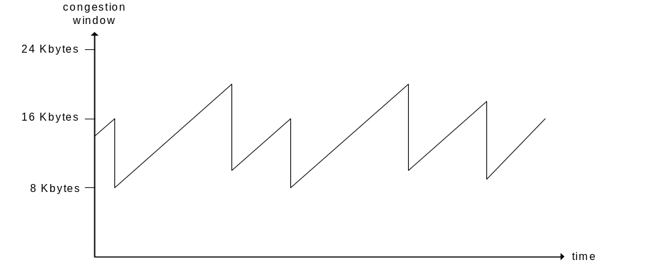
TCP AIMD
multiplicative decrease: cut CongWin in half after loss event
additive increase: increase CongWin by 1 MSS (max. seg. size) every RTT in the absence of loss events
Long-lived TCP connection
CSci4211: Transport Layer: Part II

Slide 32
Why Slow Start?
Objective
  Determine the available capacity in the first place
Idea:
  Begin with congestion window = 1 pkt
  Double congestion window each RTT
    Increment by 1 packet for each ack
Exponential growth, but slower than “one blast”
Used when
  first starting connection
  connection goes dead waiting for a timeout
CSci4211: Transport Layer: Part II
Notes:
As mentioned earlier, how we do figure the available capacity in the network when connection was just established. This is where slow start is used. Initially CongWin is set to 1 and it is doubled every RTT if there were no losses. This way CongWin grows exponentially in slow start phase. Why call this slow start? This approach is considered slower than sending all the initial data for a connection in one blast.

Slide 33

TCP Slowstart
Slowstart algorithm
Host A
Host B
initialize: CongWin = 1
for (each segment ACKed)
CongWin++
until (loss event OR
CongWin > threshold)
one segment
RTT
two segments
four segments
exponential increase (per RTT) in window size (not so slow!)
loss event: timeout (TCP Tahoe/Reno) and/or three duplicate ACKs (TCP Reno only)
time
CSci4211: Transport Layer: Part II
Notes:
Here is an illustration of slow start. CongWin starts with 1 and after a round trip time it increases to 2, then 4 and so on. This exponential growth continues till there was any loss or the threshold is reached. After reaching threshold, we enter congestion avoidance phase which is described in the next slide. The loss may be detected either thru a timeout or duplicate acks.

Slide 34
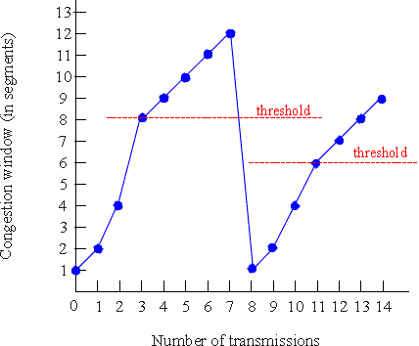
TCP Congestion Avoidance
Congestion Avoidance
/* slowstart is over */
/* Congwin > threshold */
Until (loss event) {
every W segments ACKed:
Congwin++
}
Threshold: = Congwin/2
Congwin = 1
perform slowstart
TCP Reno
w/
CSci4211: Transport Layer: Part II
Notes:
As mentioned before, a connection stays in slow start phase only till the threshold is reached. It then enters congestion avoidance phase where CongWin is increased by 1 for every round trip time. Essentially, CongWin is increased exponentially during slow start phase and linearly during congestion avoidance phase.
These phases are illustrated in the graph. Initially, CongWin is set to1. Between the round trip times 0 and 3, the connection is slow start phase and CongWin is increase to 8. At this point the threshold is reached and then on CongWin is increased by 1 for every RTT. This CongWin reaches the value of 12.
All this is when there were no losses. What happens when there is loss. Drastic action is taken. The threshold is set to current CongWin by 2. The CongWin is set to 1 and we are back in slow start phase. In the graph, where there was a loss when CongWin is 12. So the threshold is set 6, CongWin is set 1 and back to slow start phase.
This is how TCP adapts its congestion window based on packet successes/losses. This pattern of continually increasing and decreasing CongWin continues thru the lifetime of a connection and looks like a sawtooth pattern.

Slide 35
Fast Recovery/Fast Retransmit
Coarse-grain TCP timeouts lead to idle periods
Fast Retransmit
  Use duplicate acks to trigger retransmission
  Retransmit after three duplicate acks
After “triple duplicate ACKs”, Fast Recovery
  Remove slow start phase
  Go directly to half the last successful CongWin
  Enter congestion avoid phase
Implemented in TCP Reno (used by most of today’s hosts)
CSci4211: Transport Layer: Part II
Notes:
What we have described so far corresponds to a version of TCP referred to as Tahoe. It was found that coarse-grained TCP timeouts led to long periods of time during which the connection went dead waiting for the retransmission timer to expire. Because of this a new mechanism called fast retransmit was added in Reno version of TCP.
The idea of fast retransmit is based on duplicate acks. Every time a data packet arrives at the receiving side, the receiver responds with an acknowledgement, even if this sequence number of has already been acknowledged. Thus when a packet arrives out of order, TCP sends the same acknowledgement it sent the last time. When the sending side sees a duplicate ACK, it knows that the other side must have received a packet out of order, which suggests that an earlier packet might have been lost. Since, it is also possible that the earlier packet has only been delayed rather than lost, the sender waits until it sees some number of duplicate ACKs and then retransmits the missing packet. In practice, TCP retransmits after 3 duplicate acks.
Another improvement is to skip slow start phase when the loss is detected by the fast retransmit mechanism. This is called fast recovery. On detecting loss based on duplicate acks, CongWin is divided by 2 and connection enters congestion avoidance phase where congestion window is increased linearly.

Slide 36
TCP Congestion Avoidance Revisited
Congestion Avoidance
TCP Reno
w/ fast recovery
/* slowstart is over */
/* Congwin > threshold */
until (loss event) {
every W segments ACKed:
CongWin++
}
threshold: = Congwin/2
if loss event = time-out:
CongWin = 1;
perform slowstart;
if loss event = triple duplicate ACK:
CongWin: = threshold;
perform congestion avoidance;
TCP Tahoe
loss event:
triple duplicate ACKs
CSci4211: Transport Layer: Part II

Slide 37
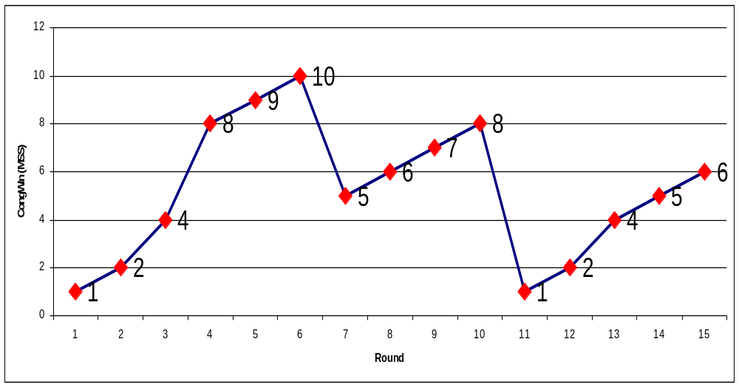
TCP Congestion Control: A Quiz
What happened during round 4, 6-7, 10-11, 13?
Can you write down the CongWin & Threshold values at each round?
CSci4211: Transport Layer: Part II

Slide 38

TCP Congestion Control: Recap
How does sender perceive congestion?
loss event = timeout or 3 duplicate ACKs
TCP sender reduces rate (CongWin) after loss event
three mechanisms:
  AIMD
  slow start
  conservative after timeout events
end-end control (no network assistance)
sender limits transmission:
LastByteSent-LastByteAcked
CongWin
Roughly,
CongWin is dynamic, function of perceived network congestion
CongWin
rate =
Bytes/sec
RTT
CSci4211: Transport Layer: Part II

Slide 39
TCP Congestion Control: Recap (cont’d)
When CongWin is below threshold, sender in slow-start phase, window grows exponentially:
  or commonly implemented using the following method:
  for each ACK received, CongWin: = CongWin + MSS;
When CongWin is above Threshold, sender is in congestion-avoidance phase, window grows linearly
  If current CongWin=W: every W segments ACKed: CongWin++
  or commonly implemented using the following method:
  for each ACK received, CongWin: = CongWin + MSS/CongWin;
When a triple duplicate ACKs occurs, threshold set to CongWin/2, and CongWin set to threshold.
When timeout occurs, threshold set to CongWin/2, and CongWin is set to 1 MSS.
CSci4211: Transport Layer: Part II

Slide 40
TCP Congestion Control: Sender Actions
State | Event | TCP Sender Action | Commentary
Slow Start (SS) | ACK receipt for previously unacked data | CongWin = CongWin + MSS, If (CongWin > Threshold) set state to “Congestion Avoidance” | Resulting in a doubling of CongWin every RTT
Congestion Avoidance (CA) | ACK receipt for previously unacked data | CongWin = CongWin+MSS * (MSS/CongWin) | Additive increase, resulting in increase of CongWin by 1 MSS every RTT
SS or CA | Loss event detected by triple duplicate ACK | Threshold = CongWin/2, CongWin = Threshold, Set state to “Congestion Avoidance” | Fast recovery, implementing multiplicative decrease. CongWin will not drop below 1 MSS.
SS or CA | Timeout | Threshold = CongWin/2, CongWin = 1 MSS, Set state to “Slow Start” | Enter slow start
SS or CA | Duplicate ACK | Increment duplicate ACK count for segment being acked | CongWin and Threshold not changed
CSci4211: Transport Layer: Part II

Slide 41
TCP Fairness
(optional material!)
Fairness goal: if K TCP sessions share same bottleneck link of bandwidth R, each should have average rate of R/K
TCP connection 1
TCP
connection 2
bottleneck
router
capacity R
CSci4211: Transport Layer: Part II

Slide 42
Why Is TCP Fair?
(optional material!)
Two competing sessions:
Additive increase gives slope of 1, as throughout increases
multiplicative decrease decreases throughput proportionally
R
equal bandwidth share
loss: decrease window by factor of 2
Connection 2 throughput
congestion avoidance: additive increase
loss: decrease window by factor of 2
congestion avoidance: additive increase
Connection 1 throughput
R
CSci4211: Transport Layer: Part II

Slide 43
Dealing with Greedy Senders
(optional material!)
Scheduling and dropping policies at routers
First-in-first-out (FIFO) with tail drop
  Greedy sender (in particular, UDP users) can capture large share of capacity
Solutions?
  Fair Queuing
    Separate queue for each flow
    Schedule them in a round-robin fashion
    When a flow’s queue fills up, only its packets are dropped
    Insulates well-behaved from ill-behaved flows
  Random Early Detection (RED) Router randomly drops packets w/ some prob., when queue becomes large!
    Hopefully, greedy guys likely get dropped more frequently!
CSci4211: Transport Layer: Part II
Notes:
So far we have talked about TCP which does congestion control at the source by reducing the rate of transmission. In a way TCP is being nice in backing off whenever there is congestion. It is not necessary that transport protocol has to be like TCP. For example, UDP doesn’t do any congestion control. So how do we deal with greedy senders that don’t react to congestion.
The solution has to be in terms of scheduling and dropping policies at the routers insides the network. Normally FIFO scheduling with trail drop policy is used. This can allow a greedy sender to capture a large share of capacity while nice TCP connections reduce their transmission rates.
One approach to address this is to implement a separate queue for each flow and schedule packets from these queues in some round robin fashion. Also, when a queue is fill, only the packets of that flow are dropped. This isolates ill-behaved from well-behaved flows.
Another approach is random early detection, where the packets may be dropped even if the queue is not full. This gives an early indication to TCP connections about the impending congestion and enables them to react sooner. Also, when the queue is full, a packet from the queue is randomly chosen for discarding instead of the newly arrived packet. This way dropped packet is likely to belong to greedy flows since many packets in queue belong to those flows.

Slide 44
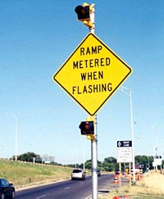
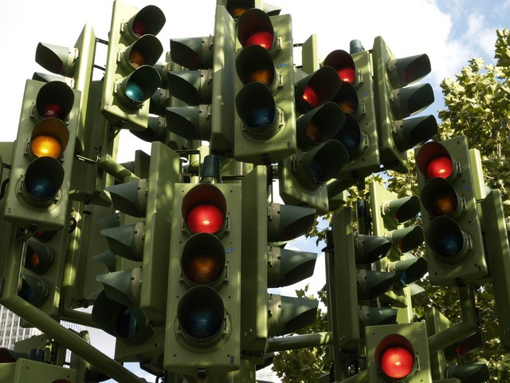
Briefly: Network-assisted Congestion Control
Analogy: traffic ramp light in highway entrance
CSci4211: Transport Layer: Part II

Slide 45

Network assisted congestion control: ATM
Two-byte ER (explicit rate) field in RM cell
  congested switch may lower ER value in cell
  sender’ send rate thus maximum supportable rate on path
EFCI bit in data cells: set to 1 in congested switch
  if data cell preceding RM cell has EFCI set, sender sets CI bit in returned RM cell
CSci4211: Transport Layer: Part II

Slide 46
Discussion: Pro and cons
End-end congestion control
Vs.
Network-assisted congestion control
Why TCP uses end-end congestion control? Benefits and problems?
CSci4211: Transport Layer: Part II

Slide 47
Pro and cons
Simple network core design in end-to-end congestion control
  Do not need to keep track of individual flow
More control in network-assisted congestion control
  Easier to deal with greedy senders
TCP extension: TCP ECN option
  ECN: explicit congestion notification (see RFC 3168)
CSci4211: Transport Layer: Part II

Slide 48
Transport Layer: Summary
Transport Layer Services
  Issues to address
  Multiplexing and Demultiplexing
UDP: Unreliable, Connectionless
TCP: Reliable, Connection-Oriented
  Connection Management: 3-way handshake, closing connection
  Reliable Data Transfer Protocols:
    Stop&Wait, Go-Back-N, Selective Repeat
    Performance (or Efficiency) of Protocols
  Estimation of Round Trip Time
TCP Flow Control: receiver window advertisement
Congestion Control: congestion window
  AIMD, Slow Start, Fast Retransmit/Fast Recovery
  Fairness Issue
CSci4211: Transport Layer: Part II

